Slide 1
Outlook for Labour Day event
Issued 9:30am 24 Oct 2025

Slide 2

Rainfall outlook for the week
Next main event arrives Mon, lingers Tue

Slide 3
Weather headlines
Waikato: typically 50-70mm for the event, with 100-120mm possible about Tongariro. Late Monday into Tuesday. Thunderstorms are possible Tuesday morning.
Tararua Range: 80-110mm late Monday iinto Tuesday
WCRC: Initially, 40-60mm with the next front about the Alps in Westland, 10-15mm elsewhere. Then, 80-110mm for Buller and Grey, with 120mm for the Ranges of northern Westland. Mostly Monday.
Note: Strengthening northwest gales on Monday ahead of the front – warning possible for South Taranaki, Central Plateau, Wellington and Wairarapa

Slide 4
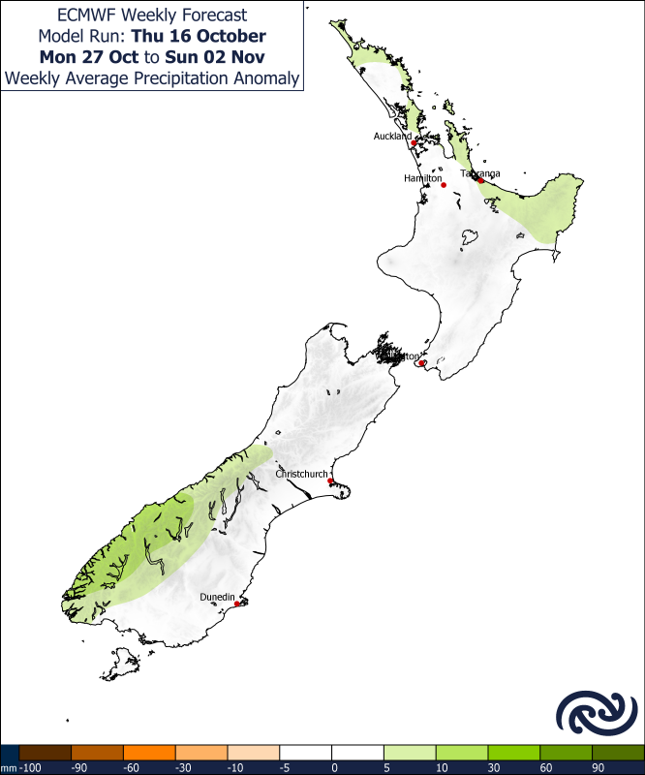
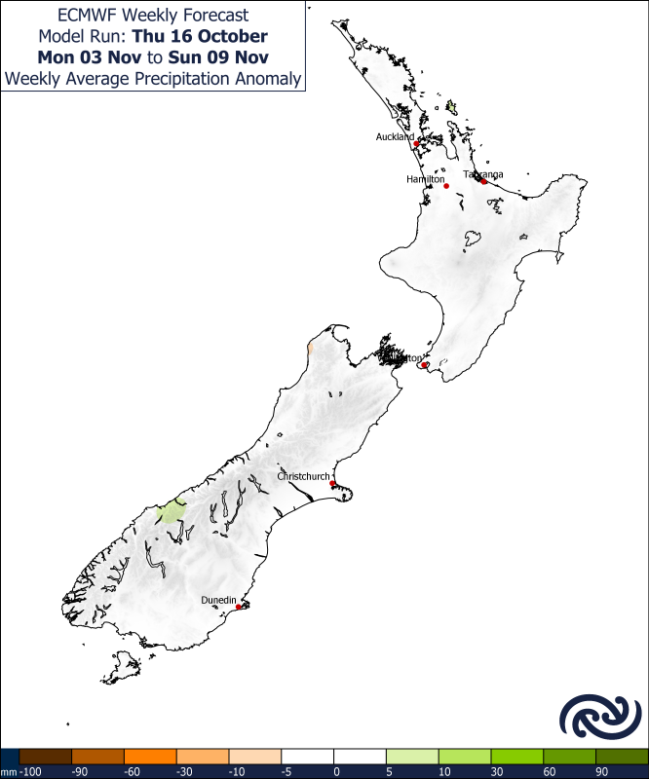

Rainfall for late next week and beyond
Weather returns to relatively benign following the Monday/Tuesday event
Several weak features (cold fronts) brings modest amounts of rain 1st week in November
Large high begins to dominate – perhaps a sign of a pattern shift to La Nina
Gradual drying pattern for the west, or, a return to ‘normal’
Monday 27 Oct to Sunday 2 Nov Monday 3 Nov to Sunday 9 Nov Monday 10 Nov to Sunday 16 Nov

